Slide 1
Batch scheduling of LOFAR pipeline runs using a DPU XML interface

Slide 2
Batch scheduling + DPU: why?
Current usage of CEP very low
Not easy to run pipelines on different Grid and HPC clusters
Ability to define dependencies between pipeline runs / tasks
Notes:
Only about 15%?
Should be made easier to run pipelines in a more automated way on other clusters
Dependencies: for instance, Calibration pipeline first, then Target pipeline, then Imaging pipeline

Slide 3
What is the DPU?
Distributed Processing Unit
Part of Astro-WISE
Framework for job submission to different kind of clusters/resource managers
Allows to define dependencies between jobs
Can basically run any “picklable” Python job
Notes:
Torque / PBS, Grid (glite)
Send list of lists (matrix) of jobs

Slide 4
Idea
Install resource manager (Torque?) on CEP
Use DPU for:
Job submission to Torque
Part of the job scheduling
Dependencies between jobs
Create a “parset combiner” on CEP
Create a “parset interface” for the DPU
Notes:
For the moment: Torque. Later SLURM?
DPU as layer on top of it. Makes it easier to switch to other clusters later.
Parset combiner: merge all information needed as input for DPU interface
DPU interface: accept this input file, translate into DPU jobs

Slide 5
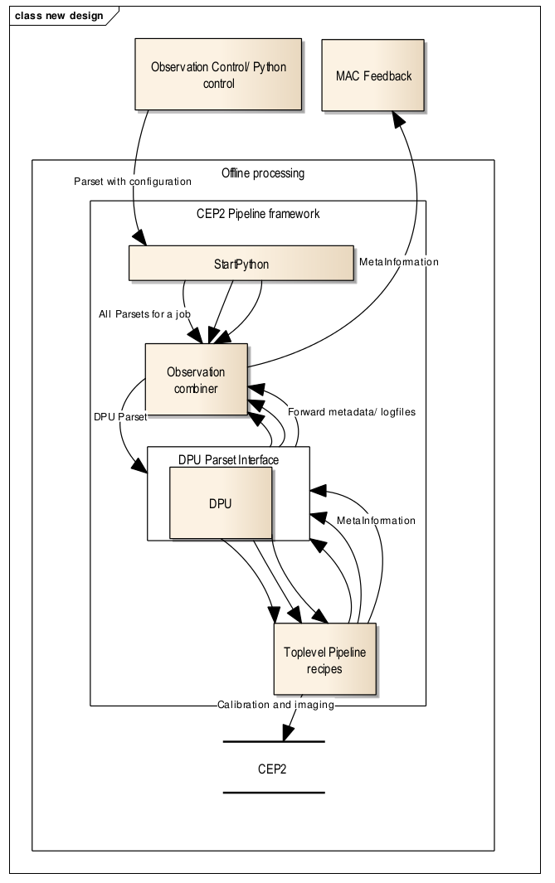
Notes:
Overview of the design
Two blocks in the middle are new.

Slide 6
Parset combiner
Combines several parsets into one file
Multiple pipelines including their dependencies
Output is XML file
Some additional information for DPU
Notes:
Combine to make it possible to add dependencies: DPU needs all information in advance
Configuration parameters, DPU name of DPU to use, etcetera. Not really used at the moment.

Slide 7
Example of XML file
Calibration+Target XML

Slide 8
DPU XML interface
Read XML file, parse pipeline information
Determine pipeline order
Parallelize pipeline tasks:
One task per input file
Sequential tasks for sequential pipelines
Submit jobs to DPU
On CEP, jobs will actually be sent to the node where the data is stored!
Each job will just start the top-level pipeline recipe
Notes:
Information includes parsets, id, etc
Pipeline order based on the predecessor values
We assume that we can parallelize on input files. There are pipelines for which this might not be possible, but it is possible for MSSS pipelines and we focused on those.
Can send extra parameters to DPU about wallclock time, memory, cores, hostnames of nodes (added)
Uses startPython.sh with some small changes to the script/environment. Also small change to pipeline configuration of Lofar build.

Slide 9
Example
Calibration pipeline
ID: observation64405
Inputs:
No predecessors
JOB 0
JOB 1
JOB N
SB000 | SB001 | … | SB00N
Target pipeline
ID: observation64406
Inputs:
Predecessors: observation64405
SB000 | SB001 | … | SB00N
Notes:
Example based on the XML file shown before

Slide 10
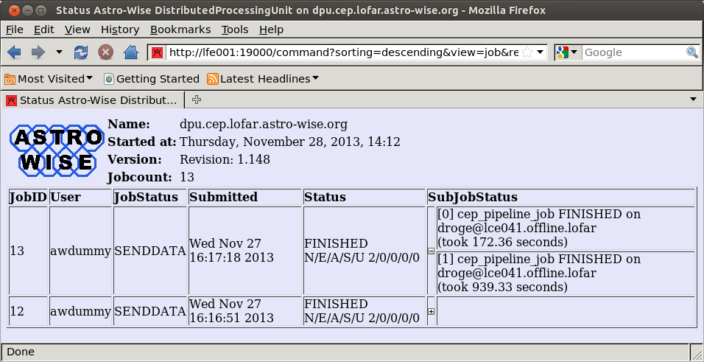
Demo
Notes:
Start DPU
Start browser: http://lfe001:19000
Clean.sh
Run.sh

Slide 11
Future work, ideas and challenges
Add more robustness, checks, etcetera
Combine job results/logs into a single file again
Expand to Grid and HPC clusters
Different DPU, same interface
How to get/store input/output data?
More jobs, more (complex) pipelines, …
Directly interact with parset combiner in an automated way
Support more resource managers, e.g. SLURM
Notes:
What to do if one or more jobs fail?
Different DPU name (can be part of XML file!), but works in exactly the same way!!
Data locality is different, pre- and post-processing step
Imaging pipeline?!
Automated
Torque has difficulties with thousands of jobs

Slide 12
Questions, comments, ideas?

